Slide 1


Software and Symbolic AI Together
CHAPTER 12 OF 12
Part B: Symbolic AI
On today’s menu
the full banquet
Everything comes to the table at once, with one last question: who do you trust to serve it?
BEFORE THIS
Ch 11: Symbolic Natural Language Processing
NEXT
Finale: Which Pip would you trust?
风味小吃 · Software and Symbolic AI · Slides V1
Notes:
TIME: about 20 s (running total under 1 min)
BEFORE THIS SLIDE:
• If this starts a new session, first recap Chapter 11 in one sentence: A symbolic system’s answer depends on the words, grammar, facts and relationships that have been represented.
READ ALOUD:
Chapter 12: Software and Symbolic AI Together. On today’s menu: the full banquet. Everything comes to the table at once, with one last question: who do you trust to serve it?
SEE ALSO: Study Guide, Chapter 12, pp. 99–112.
SOURCE: The menu line is the Study Guide’s, at the start of this chapter.
READ BEFORE CLASS:
FILE PLAN: File 12 of 12, Chapter 12: Software and Symbolic AI Together. 26 slides, about 32 minutes. It also holds the module’s finale.
GOAL: By the end, learners can say: Program logic moves the data, and rules make decisions that people can inspect. A trained model can read varied wording, but it can still guess.
PREPARE: Everyone needs paper and a pen, and keeps what they write until the finale. The live Scratch and Machine Learning for Kids demo is optional. Rule-Pip is ready as Supporting_Files\Rule_Pip.sb3. Model-Pip must be trained before class: allow 25 minutes. The demo runs after the vote on the slide “Predict: three commands, two Pips”, whose notes hold the steps. If it cannot be used, the following slides hold the team’s recorded results and screenshots.
ACTIVITIES:
• Slide 2, about 1 min 55 s: One decision, two ways: what about Tom?
• Slide 5, about 1 min 45 s: New policy: pay the fine, then borrow
• Slide 9, about 1 min 45 s: Which Pip would you trust with the fan?
• Slide 12, about 2 min 25 s: Predict: three commands, two Pips
• Slide 15, about 1 min 15 s: Threshold rule: below the line, ask again
• Slide 19, about 1 min 25 s: Chapter 12: last challenge
• Slide 22, about 55 s: Which approach suits each job?
IF SHORT OF TIME: Skip the optional live demo first. Then skip the extensions on “Program: refused. Rules: no conclusion”, “A hybrid system: the program moves data, rules decide”, “Threshold rule: below the line, ask again” and “Neither approach is enough for everything”. If you are still short, read only the fourth row of “When information is imperfect, a good system says so”. Do not cut the threshold slides or the re-vote: they are the finale.
IF MANY GET IT WRONG: Key check: the votes on “One decision, two ways: what about Tom?”. If most of the room says the rules refuse Tom, ask them to point to the rule that adds “refused”: there is none in this set, so the rules cannot say it. R4 from Chapter 9 is left out on purpose. If many miss the threshold predictions, read the rows aloud one by one: below the line asks again, at or above the line runs.
LIKELY QUESTIONS:
• Q: Why not write an exact rule for every sentence? A: Nobody can list every sentence a person might type. The rules are never complete, as with the grammar in Chapter 11.
• Q: Why not set the threshold very high? A: Then it also asks about right answers: at 96%, four of the five commands asked again had sensible labels. A threshold also cannot tell whether a label makes sense, so safety rules are still needed.
• Q: Does 99% mean the model is right? A: No. Confidence is the model’s own score for the label it chose. It does not prove that the label is right.
• Q: Is a model plus a safety rule a hybrid system? A: Not in this module’s sense. Here, hybrid means program logic plus rules. A neural model plus rules is neuro-symbolic AI, an extension topic that is not examined. The threshold reasoning is examined.
TIMES: Each time assumes speech at about 120 words a minute, the pauses written in the script and a few seconds to change the slide. Allow a little extra for settling after pair work and for questions.
CHECK: On a computer without Bahnschrift and Segoe UI, or a version of PowerPoint without Morph, the slides may look different. Use the matching PDF in PDF_copies instead, and read from Reading_Scripts, because the PDF copies carry no notes.

Slide 2

One decision, two ways: what about Tom?
CH
12
Predict first
Tom: valid card, one overdue book, book available
The program from Chapter 5
R1 and R2 alone, from Chapter 9
IF card not valid
refuse: card invalid
ELSE IF overdue books
refuse: books overdue
ELSE IF copy not available
refuse: copy unavailable
ELSE approve and record
R1 IF valid card
AND no overdue books
THEN may borrow
R2 IF may borrow
AND book available
THEN approved
Approved, refused or no conclusion? Predict both: 45 seconds
风味小吃 · Software and Symbolic AI · Slides V1
Notes:
TIME: about 1 min 55 s (running total about 2 min)
BEFORE THIS SLIDE:
• The chain on screen is the Chapter 5 loan chain with shorter lines and without its five-book line, because R1 and R2 have no limit either. Tom’s result is the same with or without that line.
READ ALOUD:
Chapter 5 wrote the loan decision as a program. Chapter 9 wrote it as rules. Today we run one member through both.
Here is Tom. He has a valid card and one overdue book, and the book is available.
On the left, follow the chain from the top. On the right, try to fire R1 and R2.
What does each one conclude: approved, refused, or no conclusion? You have 45 seconds, and then we vote.
[Pause 45 seconds.]
First, the program. Hands up for approved. Now refused. Now no conclusion.
[Take a show of hands.]
Now the rules. Hands up for approved. Now refused. Now no conclusion.
[Take a show of hands.]
Let’s trace Tom through both.
EXPECTED ANSWER: The program says refuse, because books are overdue. R1 and R2 reach no conclusion.
SEE ALSO: Study Guide Chapter 12, “One decision, two ways”, and the loan chain in Chapter 5. Test Bank M23.

Slide 3
Program: refused. Rules: no conclusion
CH
12
Check
Tom: valid card, one overdue book, book available
The program from Chapter 5
R1 and R2 alone, from Chapter 9
Is the card not valid?
No, so it carries on
R1: “no overdue books” is false
R1 does not fire
Does Tom have overdue books?
Yes, so it stops here
R2: “may borrow” never added
R2 does not fire
“Refuse: books overdue”
No conclusion
A fixed procedure, or knowledge an engine reasons from
风味小吃 · Software and Symbolic AI · Slides V1
Notes:
TIME: about 1 min 40 s (running total about 4 min)
READ ALOUD:
Start with the program. Is the card not valid? No, so it carries on. Does Tom have overdue books? Yes. So the chain stops there, and says: refuse, books overdue.
Now the rules. R1 needs no overdue books, and Tom has one, so R1 does not fire. R2 needs may borrow, which was never added. So R2 does not fire either.
No rule fires, so there is no conclusion. No conclusion means no rule supports an answer. Refused needs a rule that says so, such as R4 from Chapter 9.
Here is the real difference. The chain is a fixed procedure. The rules are separate knowledge that an engine reasons from. That is what Chapter 1’s test was asking: how is the output produced?
[Extension: skip if short of time.]
In a program, the policy sits in the conditions and their order, and a final branch can produce an output for cases not covered. In rules, the policy is explicit, and can be easier to inspect or change.
Both need accurate requirements and tests. Neither should treat missing information as proof of the opposite.
[End of extension.]
But the library does not have to choose. Ordinary software and symbolic AI can work together.
SEE ALSO: Study Guide Chapter 12, “One decision, two ways”. Test Bank M23.
SOURCE: Worked by the team from the chain in Study Guide Chapter 5 and R1 and R2 in Chapter 9.

Slide 4
A hybrid system: the program moves data, rules decide
CH
12
Program logic: input, store, display
Check-out screen
Database
Result screen
facts
conclusion
Rule-based component: reasoning
Working memory and knowledge base
Inference engine
风味小吃 · Software and Symbolic AI · Slides V1
Notes:
TIME: about 55 s (running total about 5 min)
READ ALOUD:
Look at the top row. A program can collect input, store information and display a result.
Now the lower box. This part holds the policy as explicit rules, and it infers a conclusion. Facts go down, and a conclusion comes back up.
A system that divides the work this way is called a hybrid system. The program logic moves the data, and the rules make the decision.
[Extension: skip if short of time.]
In this module, hybrid means program logic plus rules. A neural model plus rules has another name, neuro-symbolic AI. That is an extension topic, not examined here.
[End of extension.]
Now the library changes its policy.
SEE ALSO: Study Guide Figure 12.1. Test Bank M36.

Slide 5
New policy: pay the fine, then borrow
CH
12
Predict first
Ken: valid card, one overdue book, fine paid, book available
R1 IF valid card AND no overdue books THEN may borrow
R2 IF may borrow AND book available THEN approved
R4 IF overdue books THEN refused
R5 IF valid card AND overdue books AND fine paid
THEN may borrow
Ken: approved, refused, both or neither? You have 45 seconds
风味小吃 · Software and Symbolic AI · Slides V1
Notes:
TIME: about 1 min 45 s (running total about 7 min)
READ ALOUD:
Here is the new policy: a member with overdue books may borrow if they have paid the fine. R5 expresses it, in bold.
The program version needs a fine paid input and an updated condition. Both versions need old and new tests. The changes are similar in size. The difference is how easily a librarian can read them.
Now look at Ken, at the top. Trace him through all four rules. Is he approved, refused, both or neither? You have 45 seconds, and then we vote.
[Pause 45 seconds.]
Hands up for approved. Now refused. Now both. Now neither.
[Take a show of hands.]
Let’s trace Ken.
EXPECTED ANSWER: Both. R1 does not fire. R5 adds may borrow, R2 adds approved, and R4 adds refused.
SEE ALSO: Study Guide Activity 12.1. Test Bank T23.

Slide 6
Add one rule, and two rules can clash
CH
12
Check
Ken: valid card, one overdue book, fine paid, book available
R5 may borrow
R2 approved
Both at once: the rules conflict
overdue book
R4 refused
How would you rewrite R4, so that Ken is not refused?
风味小吃 · Software and Symbolic AI · Slides V1
Notes:
TIME: about 1 min 30 s (running total about 8 min)
READ ALOUD:
Start with R1. It does not fire, because Ken has an overdue book. R5 does fire, because Ken has a valid card, an overdue book and a paid fine.
R5 adds may borrow, and R2 uses that to add approved. You can see that path in green.
But look at the row below. R4 fires from the overdue fact alone, and adds refused. So Ken is approved and refused, both at once. We added one rule, and now the rules conflict.
How would you rewrite R4, so that Ken is not refused? Think for 20 seconds, and then call out your rewrite.
[Pause 20 seconds.]
[Take one or two answers.]
Here is one fix.
EXPECTED ANSWER: Add the fine to R4, so that it fires only when the fine is not paid.
SEE ALSO: Study Guide Activity 12.1. Test Bank M35.

Slide 7
The fix: rewrite R4 so it checks the fine
CH
12
Check
Old R4 IF overdue books THEN refused
New R4 IF overdue books AND fine not paid THEN refused
Test | Which rules fire | Conclusion
Ken, fine paid | R5, then R2 | approved only
Ken, fine not paid | New R4 | refused only
Or set a clear priority. Test both cases, and run the old tests again
风味小吃 · Software and Symbolic AI · Slides V1
Notes:
TIME: about 1 min 5 s (running total about 9 min)
READ ALOUD:
The old R4 fired on the overdue fact alone. The new R4 fires only when the fine is not paid. That is one extra condition.
Now test it both ways. Ken with his fine paid: R5 fires, then R2, and the new R4 does not fire. So he is approved, and nothing else.
Ken with his fine not paid: R5 does not fire, so R2 cannot. The new R4 fires. So he is refused, and nothing else.
There is another way out: keep both rules, and set and document a clear priority. Either way, test a member who has paid and one who has not. Then run the old tests again.
A conflict is one way information can go wrong. Here are the others.
SEE ALSO: Study Guide Chapter 12, “When information is imperfect” and its conflict example.
SOURCE: New R4 worked by the team from Activity 12.1 and the Guide’s conflict example.

Slide 8
When information is imperfect, a good system says so
CH
12
Problem | Good system response
Missing | Ask for the fact, or report that the rule cannot decide
Conflicting | Rewrite the rules, or document a clear priority
Outdated | A responsible person updates, tests and re-checks
Low-confidence model output | Ask for clarification, and apply explicit safety rules
Which earlier slides showed the first two rows?
风味小吃 · Software and Symbolic AI · Slides V1
Notes:
TIME: about 1 min 20 s (running total about 11 min)
READ ALOUD:
The table pairs each problem with a good response. Here is why each one is a problem.
Missing: a blank field does not prove the opposite fact. Conflicting: rules or facts can support opposite conclusions.
Outdated: a correct engine can still apply an obsolete rule or stale record. Low-confidence model output: a predicted label may be wrong even when the model returns one.
Now look back. Which earlier slides showed the first two rows? Call out your answer.
[Pause 10 seconds, then take a few answers.]
Missing was the blank box in Chapter 6. Conflicting was Ken, just now.
That fourth row is new. It leads to the best part of the lesson.
EXPECTED ANSWER: Missing: the blank box in Chapter 6. Conflicting: Ken, just now.
SEE ALSO: Study Guide Chapter 12, “When information is imperfect”. Test Bank T24.

Slide 9


Which Pip would you trust with the fan?
CH
12
Predict first
A visitor types: “make me a sandwich”
Rule-Pip
Model-Pip
the rule-based assistant
the machine-learning assistant
written rules
trained on example sentences
does nothing
switches on the fan
Write down your choice and one reason. Keep it for the end.
风味小吃 · Software and Symbolic AI · Slides V1
Notes:
TIME: about 1 min 45 s (running total about 12 min)
READ ALOUD:
The library builds two versions of Pip, to control the reading-room fan and lamp. Rule-Pip is the rule-based assistant, with written rules. Model-Pip is the machine-learning assistant, trained on example sentences.
Model-Pip is a text classifier. That is a small machine-learning model. It reads a sentence and puts it into one of the labels you chose.
Now a visitor types: “make me a sandwich.” Rule-Pip does nothing. Model-Pip switches on the fan.
So, which version of Pip would you trust with the reading-room fan? Write down one choice and one reason. Keep it. We return to it at the very end. You have 30 seconds.
[Pause 30 seconds while they write.]
Now a show of hands. Who chose Rule-Pip? Who chose Model-Pip?
[Take a show of hands. Do not resolve it here.]
We will leave that open for now. Let’s see how each one was built.
EXPECTED ANSWER: There is no answer yet. It depends on the job, and the finale settles it. Do not resolve it here.
SEE ALSO: Study Guide Chapter 12, Predict first.

Slide 10

Rule-Pip is built from exact words
CH
12
An exact match sends turn-fan-on
The five exact wordings in the script
“Fan on”
“Fan on please”
“Fan off”
“Lamp on”
“Lamp off”
风味小吃 · Software and Symbolic AI · Slides V1
Notes:
TIME: about 40 s (running total about 13 min)
READ ALOUD:
Both Pips do the same job. One is built from exact rules, and the other from trained examples.
This is part of Rule-Pip’s script, in Scratch. Read the green part. If the answer equals Fan on, or the answer equals Fan on please, then it sends the message turn fan on.
The ringed words are all that this rule looks for. Below are the five exact wordings in the whole script.
Now let’s see the other build.
SEE ALSO: Study Guide Hands-on 12.2, Figure 12.2.
SOURCE: Rule script: the professor’s PPT 2024, chap4, slide 50, built in Scratch (Scratch Foundation). Cropped from the Study Guide figure.

Slide 11
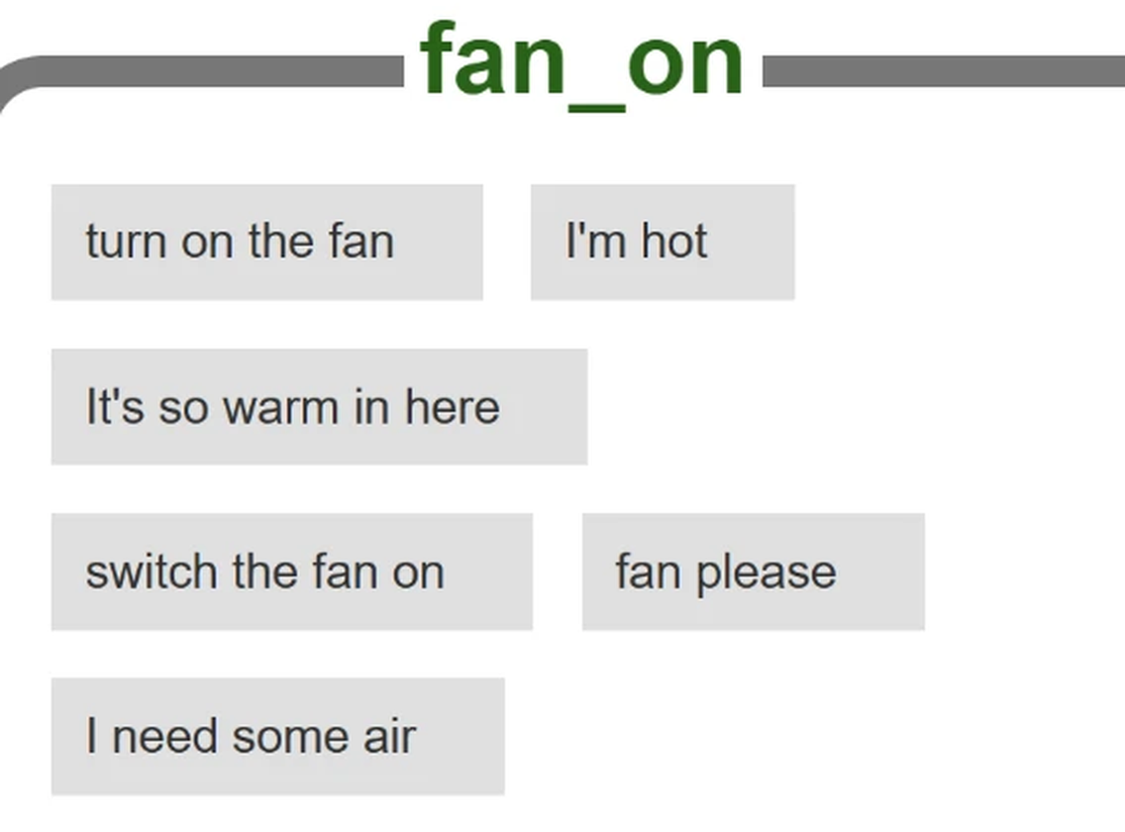
Model-Pip is trained on example sentences
CH
12
Six examples
for each of four labels
fan_on
fan_off
lamp_on
lamp_off
It reads a sentence and picks one of these labels
风味小吃 · Software and Symbolic AI · Slides V1
Notes:
TIME: about 35 s (running total about 14 min)
READ ALOUD:
Model-Pip has no list of exact wordings. It has labels, and examples for each one.
This is the team’s fan on label, with its six training examples. There are four labels in all, with six examples each.
[Pause 5 seconds so people can read the examples.]
So here is the question. What will each version do with new wording? Before seeing results, let’s predict them.
SEE ALSO: Study Guide Hands-on 12.2, Figure 12.3. All four lists are in the supporting file fan_lamp_training_examples.txt.
SOURCE: Training examples: the team’s screenshot from Machine Learning for Kids (D. Lane), 4 November 2026.

Slide 12
Predict: three commands, two Pips
CH
12
Predict first
Command typed | Rule-Pip | Model-Pip
turn on fan | ? | ?
I’m really hot | ? | ?
It’s too dark to read | ? | ?
Model-Pip’s labels: fan_on, fan_off, lamp_on, lamp_off
45 seconds: Rule-Pip’s action or “nothing”? Model-Pip’s label?
风味小吃 · Software and Symbolic AI · Slides V1
Notes:
TIME: about 2 min 25 s (running total about 16 min)
BEFORE THIS SLIDE:
• LIVE OR FALLBACK. The optional live demo belongs on this slide, after the vote, and takes about 3 minutes. Fallback: if it is not ready, or a site fails, skip it and click on. The next slides hold the team’s recorded results and screenshots, so the lesson is complete without internet.
• Rule-Pip is ready: in Scratch, use File, then Load from your computer, and open Supporting_Files\Rule_Pip.sb3. Click the green flag once. The script keeps asking, so type each command in turn. Open it once before class to check it. It has been run on Scratch’s engine, not in the editor.
• Model-Pip still has to be trained before class, because the model cannot be saved in a file. In Machine Learning for Kids, choose Get started, then Try it now. No account is needed, but the site first asks you to pass a “Verify you are human” check, and this mode gives one project, for a few hours, on one computer. Then follow Study Guide Hands-on 12.2, Part B, with the lists in Supporting_Files\fan_lamp_training_examples.txt. Allow 25 minutes before class, on the computer you will teach from.
• To rebuild Rule-Pip by hand, follow Study Guide Hands-on 12.2, Part A.
• Scratch shows only the reply, not the confidence. Use the website for the percentages.
READ ALOUD:
Here are three new commands. None of them was a training example in exactly these words.
For each one, predict Rule-Pip’s action, or nothing. Then predict Model-Pip’s label. The four labels are on screen. You have 45 seconds, and then we vote.
[Pause 45 seconds.]
Now one command at a time. For each one, hands up if Rule-Pip does something. Then call out Model-Pip’s label.
[Pause 60 seconds for the three rounds of hands and the called-out labels.]
[LIVE OR FALLBACK. Live: test only these three commands now, about 3 minutes, not counted in the times here. Say what each version did, and that a live run can differ from the team’s record. Fallback: go straight on.]
Now, here are the team’s recorded results.
EXPECTED ANSWER: “turn on fan”: Rule-Pip nothing, Model-Pip fan_on. “I’m really hot”: Rule-Pip nothing, Model-Pip fan_on. “It’s too dark to read”: Rule-Pip nothing, Model-Pip lamp_on. These are the team’s recorded results.
SEE ALSO: Study Guide Hands-on 12.2, the predict sheet.

Slide 13
All eight: Rule-Pip is exact, Model-Pip guesses
CH
12
Command typed | Rule-Pip (Scratch) | Model-Pip (website)
Fan on | Fan turns on | fan_on, 99%
fan on | Fan turns on | fan_on, 99%
Fan on please | Fan turns on | fan_on, 99%
turn on fan | Nothing | fan_on, 95%
I’m really hot | Nothing | fan_on, 94%
It’s too dark to read | Nothing | lamp_on, 74%
turn the fan off please | Nothing | fan_off, 87%
make me a sandwich | Nothing | fan_on, 18%
The team’s recorded results, 4 November 2026. Another run may differ.
Which handles new wording better? Which is easier to inspect?
风味小吃 · Software and Symbolic AI · Slides V1
Notes:
TIME: about 2 min (running total about 18 min)
BEFORE THIS SLIDE:
• If you ran the demo live and your results differ, say so here, and compare the pattern, not the exact numbers.
READ ALOUD:
Compare the three ringed rows with your votes. Rule-Pip did nothing for all three. “turn on fan” fails because it is not the exact words of any rule.
Model-Pip gave a sensible label each time. Each percentage is confidence: the model’s own score for the label it chose.
These are the team’s recorded results, from 4 November 2026. They come from one model, so treat them as a record, not a guarantee. On another run, percentages may differ, and sometimes a label may too.
Now the other rows. “fan on” works because Scratch’s equals block ignores capital letters. “Fan on please” works because there is a rule for exactly this sentence.
High confidence does not prove the label is right. And the model picks a label even when its confidence is very low. Look at the bottom row.
Two questions, at the bottom of the screen. Which assistant handles different wording better? Which decision is easier to inspect? Call out your answers.
[Pause 15 seconds, then take a few answers.]
Model-Pip handles wording better. Rule-Pip is easier to inspect.
Now let’s look at the sandwich itself.
EXPECTED ANSWER: Model-Pip handles wording better. Rule-Pip is easier to inspect.
SEE ALSO: Study Guide Hands-on 12.2, Figure 12.4 and the observation table. Test Bank M28.
SOURCE: The team’s test, Machine Learning for Kids and Scratch, 4 November 2026.

Slide 14
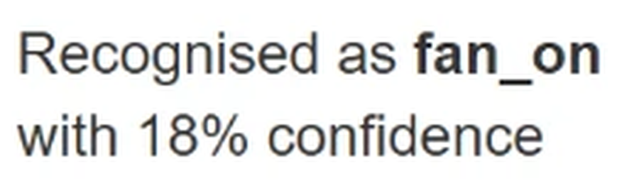
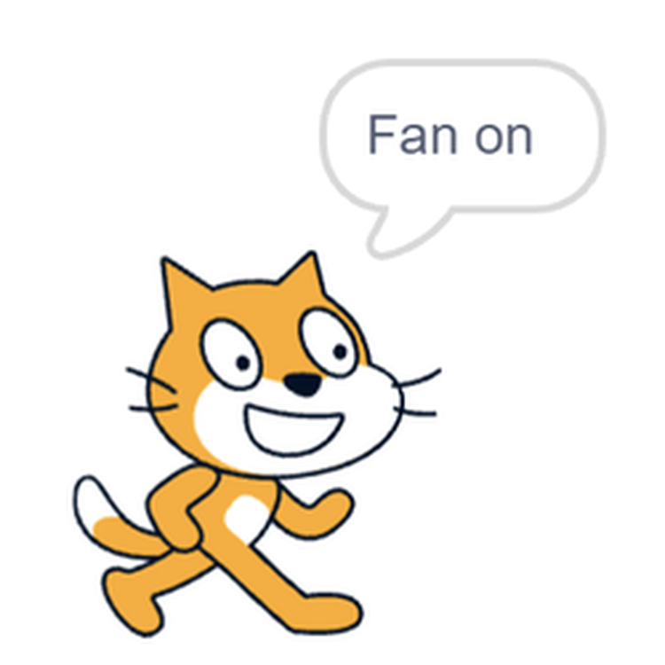
A sandwich request, and the cat says “Fan on”
CH
12
On the website, 4 November 2026
In Scratch, the same day
A label, at very low confidence
The script checks only the label
Pip says Model-Pip heard ‘make me a sandwich’ and switched on the fan. Rule-Pip heard it and did nothing. For the record, nobody got a sandwich.
Common mistake: “The model gave an answer, so it must know.”
风味小吃 · Software and Symbolic AI · Slides V1
Notes:
TIME: about 1 min 10 s (running total about 19 min)
READ ALOUD:
On the left is the website, in the team’s recorded test. It recognised “make me a sandwich” as fan on, with 18 percent confidence.
On the right is Scratch, where the cat speaks the reply. The script checked only the label, so the cat said “Fan on”. Scratch shows only the reply, not the confidence.
A label is a guess from examples. Confidence tells you how strong the guess is, not whether it is right.
“The model gave an answer, so it must know”. That is the common mistake.
Pip says: “Model-Pip heard ‘make me a sandwich’ and switched on the fan. Rule-Pip heard it and did nothing. For the record, nobody got a sandwich.”
So let’s put a rule between the model and the fan. You choose the rule.
SEE ALSO: Study Guide Figures 12.4 and 12.7.
SOURCE: The team’s screenshots from Machine Learning for Kids and Scratch, 4 November 2026.

Slide 15
Threshold rule: below the line, ask again
CH
12
Try it
Fan on
fan_on 99%
fan on
fan_on 99%
Fan on please
fan_on 99%
turn on fan
fan_on 95%
I’m really hot
fan_on 94%
turn the fan off please
fan_off 87%
It’s too dark to read
lamp_on 74%
make me a sandwich
fan_on 18%
The team’s recorded results, 4 November 2026
50%
At a 50% threshold, which commands get asked again?
风味小吃 · Software and Symbolic AI · Slides V1
Notes:
TIME: about 1 min 15 s (running total about 20 min)
READ ALOUD:
The script acts on the label alone. So design a rule that stands between the model and the fan. If confidence is below your threshold, then ask the person to repeat the command.
The bars show the team’s recorded percentages again. The line marks the threshold. We start at 50 percent.
Which commands would be asked again? You have 15 seconds, and then call them out.
[Pause 15 seconds, then take a few answers.]
[Extension: skip if short of time.]
A model checked by rules is the neuro-symbolic idea in miniature. The threshold reasoning is examined. That name is not.
[End of extension.]
Let’s apply the rule.
EXPECTED ANSWER: Only the sandwich, at 18 percent.
SEE ALSO: Study Guide Hands-on 12.2, Part C.

Slide 16
At 50%, only the sandwich is asked again
CH
12
Check
Fan on
fan_on 99%
runs
fan on
fan_on 99%
runs
Fan on please
fan_on 99%
runs
turn on fan
fan_on 95%
runs
I’m really hot
fan_on 94%
runs
turn the fan off please
fan_off 87%
runs
It’s too dark to read
lamp_on 74%
runs
make me a sandwich
fan_on 18%
asks again
The team’s recorded results, 4 November 2026
50%
Is 50% safe enough? Move the line to 80%. What changes?
风味小吃 · Software and Symbolic AI · Slides V1
Notes:
TIME: about 55 s (running total about 21 min)
READ ALOUD:
Read the labels on the right. Only the sandwich says asks again. One line of rule has fixed the sandwich.
But is 50 percent safe enough? What changes if we move the line to 80 percent? You have 15 seconds, and then call it out.
[Pause 15 seconds, then take a few answers.]
Let’s move the line to 80 percent.
EXPECTED ANSWER: At 80 percent, “It’s too dark to read”, at 74 percent, is asked again as well.
SEE ALSO: Study Guide Hands-on 12.2, Check Part C.

Slide 17
At 80%, a right answer gets asked again too
CH
12
Check
Fan on
fan_on 99%
runs
fan on
fan_on 99%
runs
Fan on please
fan_on 99%
runs
turn on fan
fan_on 95%
runs
I’m really hot
fan_on 94%
runs
turn the fan off please
fan_off 87%
runs
It’s too dark to read
lamp_on 74%
asks again
make me a sandwich
fan_on 18%
asks again
The team’s recorded results, 4 November 2026
80%
Now 96%. How many get asked again? You have 10 seconds
风味小吃 · Software and Symbolic AI · Slides V1
Notes:
TIME: about 45 s (running total about 22 min)
READ ALOUD:
Look at the ringed row. “It’s too dark to read”, at 74 percent, is asked again, although its label was right.
Now we move the line to 96 percent. How many commands will be asked again? You have 10 seconds.
[Pause 10 seconds, then take a few answers.]
Let’s see.
EXPECTED ANSWER: Five. Only the three “fan on” commands, at 99 percent, run.
SEE ALSO: Study Guide Hands-on 12.2, Check Part C.

Slide 18
At 96%, five are asked again. No threshold is perfect
CH
12
Fan on
fan_on 99%
runs
fan on
fan_on 99%
runs
Fan on please
fan_on 99%
runs
turn on fan
fan_on 95%
asks again
I’m really hot
fan_on 94%
asks again
turn the fan off please
fan_off 87%
asks again
It’s too dark to read
lamp_on 74%
asks again
make me a sandwich
fan_on 18%
asks again
The team’s recorded results, 4 November 2026
96%
Too low lets wrong labels act. Too high asks about right ones.
风味小吃 · Software and Symbolic AI · Slides V1
Notes:
TIME: about 50 s (running total about 23 min)
READ ALOUD:
Five commands are asked again. Only the three “fan on” commands, at 99 percent, run. And four of those five have sensible labels.
So no threshold is perfect. Too low lets wrong labels act, and too high asks about right ones.
A threshold also cannot tell whether a label makes sense, so explicit safety rules are still needed. A safer program would also record the prediction, confidence and decision for later review.
Remember, these are the team’s recorded percentages of 4 November 2026, and another run may differ.
Now let’s bring this chapter to a close.
SEE ALSO: Study Guide Try it 12.3. Test Bank M24; O06 after Ch. 12.

Slide 19

Chapter 12: last challenge
CH
12
Try it
Suppose “lock the door” gets fan_on at 92%, and the line is at 80%. What happens? Is that safe?
Tell a neighbour. You have 30 seconds.
风味小吃 · Software and Symbolic AI · Slides V1
Notes:
TIME: about 1 min 25 s (running total about 24 min)
READ ALOUD:
Before we close this chapter, one last challenge. Suppose “lock the door” gets fan_on at 92%, and the line is at 80%. What happens? Is that safe? Tell a neighbour.
[Pause 30 seconds.]
[Take one or two answers.]
It runs: 92 percent is above the line, so the fan turns on, although nobody asked for the fan. A threshold cannot tell whether a label makes sense, so explicit safety rules are still needed. For example: if the sentence names anything other than the fan or the lamp, do not act, and ask.
EXPECTED ANSWER: It runs: 92 percent is above the line, so the fan turns on, although nobody asked for the fan. A threshold cannot tell whether a label makes sense, so explicit safety rules are still needed. For example: if the sentence names anything other than the fan or the lamp, do not act, and ask.

Slide 20
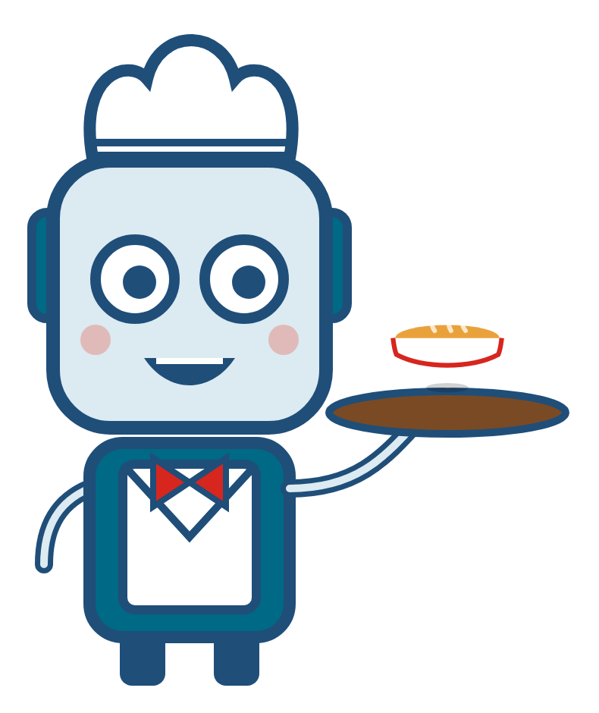
Chapter 12: mission complete
CH
12
Program logic moves the data, and rules make decisions that people can inspect. A trained model can read varied wording, but it can still guess.
Pip’s log You have helped Pip from its first day to here: from “is a calculator AI?” to knowing what a system may conclude, and when it must ask.
STUDY GUIDE
Activity 12.1 and Hands‑on 12.2
VIDEO TUTORIAL
Video 07: Language, Rules, and Two Assistants
TEST BANK
T23–T24, M23–M24, M28, M36; O03, O06 after Ch. 12
风味小吃 · Software and Symbolic AI · Slides V1
Notes:
TIME: about 40 s (running total about 25 min)
READ ALOUD:
Program logic moves the data, and rules make decisions that people can inspect. A trained model can read varied wording, but it can still guess.
Pip’s log: You have helped Pip from its first day to here: from “is a calculator AI?” to knowing what a system may conclude, and when it must ask.
Your next steps are on the slide. For the rule conflict, use Activity 12.1.
You wrote something down earlier. Time to look at it.

Slide 21

Would you change your answer?
Look at what you wrote. Vote again.
风味小吃 · Software and Symbolic AI · Slides V1
Notes:
TIME: about 1 min 5 s (running total about 26 min)
READ ALOUD:
Look at the choice you wrote down, and your one reason.
[Pause 10 seconds while they find it.]
When you wrote that, you had only seen Rule-Pip do nothing and Model-Pip switch on the fan. Since then, you have seen the exact wording, the confidence scores and the moving line.
Would you change your answer now? Let’s vote again. Hands up for Rule-Pip. Now hands up for Model-Pip. And hands up if your answer is now: it depends on the job.
[Take the vote again and note any change.]
Keep that vote in mind. One more decision first.
EXPECTED ANSWER: A good answer depends on the job. Rule-Pip for anything that must be explained or must be safe. Model-Pip for understanding messy wording, with rules checking it before it acts.

Slide 22
Which approach suits each job?
FINAL
Try it
a
Save a loan record
b
Decide a loan, and show why
c
Understand “it’s boiling in here”
Program, rules or a trained model? 20 seconds, then hands up.
风味小吃 · Software and Symbolic AI · Slides V1
Notes:
TIME: about 55 s (running total about 27 min)
READ ALOUD:
On day one I promised you could explain, trace and decide. So decide.
Three jobs are on screen. For each one: a program, rules or a trained model? You have 20 seconds, then hands up for each.
[Pause 20 seconds.]
[Take a show of hands for each job. Do not confirm yet.]
Let’s see how the parts fit.
EXPECTED ANSWER: (a) A program: moving and storing data needs no reasoning. (b) Rules: they decide and can show why. (c) A trained model, with rules checking it before it acts.
SEE ALSO: Study Guide, learning goals and “Pip’s last day as a trainee”.
SOURCE: The three jobs are the team’s own check of the module’s third goal: decide which job suits a program, rules or a trained model.

Slide 23
Neither approach is enough for everything
FINAL
Program logic
moves the data
Part A: steps, data, tests
Explicit rules
give decisions you can
explain and check
Part B: facts and chaining
A trained model
can help with
messy input
Chapter 12: with rules checking it
Knowing which job suits which approach is the main lesson of this module
风味小吃 · Software and Symbolic AI · Slides V1
Notes:
TIME: about 1 min 45 s (running total about 29 min)
READ ALOUD:
So, which Pip would you trust? A good answer depends on the job.
[Pause 3 seconds.]
Rule-Pip for anything that must be explained or must be safe. Model-Pip for understanding messy wording, with rules checking it before it acts.
Rule-Pip shows the same limit as Chapter 11. “turn on fan” fails for the same reason that a grammar rejects a sentence it has no rule for. The rules are never complete.
The trained model copes with new wording. But it cannot show a readable reason, and it picked a label even for a sandwich.
The three boxes answer your three jobs. Saving a record is program logic, from Part A. Deciding and showing why is rules, from Part B. Messy wording is the trained model, with rules checking it.
[Extension: skip if short of time.]
Symbolic ideas ran through the module. Chapter 6 said what symbolic AI is. Chapter 10 used it for planning, so every step of a route can be traced. And Chapter 11 used it for language.
[End of extension.]
[Say this slowly.]
Knowing which job suits which approach is the main lesson of this module.
[Pause 3 seconds.]
One last thing. The visitor is still waiting for an answer.
SEE ALSO: Study Guide, “Pip’s last day as a trainee”.

Slide 24
Back to the visitor’s question
FINAL
“Are you intelligent, or do you just follow instructions?”
“I follow instructions. When they are facts and rules, I can infer a conclusion and show you why. When I have no rule, or a blank, I must ask.”
So, can a machine reason?
It can draw conclusions from the facts and rules it is given, and show why. People remain responsible for checking it.
风味小吃 · Software and Symbolic AI · Slides V1
Notes:
TIME: about 1 min 25 s (running total about 30 min)
READ ALOUD:
Let’s go back to the visitor’s question, from Pip’s first day.
[Read the question slowly.]
“Are you intelligent, or do you just follow instructions?”
[Read Pip’s answer slowly.]
“I follow instructions. When they are facts and rules, I can infer a conclusion and show you why. When I have no rule, or a blank, I must ask.”
[Pause 3 seconds.]
Remember, Pip is a made-up character. The real point is that a system’s answer is only as good as the knowledge behind it.
And that answers the question on our very first slide. So, can a machine reason?
It can draw conclusions from the facts and rules it is given, and show why. It cannot conclude what its knowledge does not support. And people remain responsible for checking it.
[Pause 3 seconds.]
One trial is still waiting, and it is yours.
SEE ALSO: Study Guide, “Pip’s last day as a trainee”.

Slide 25
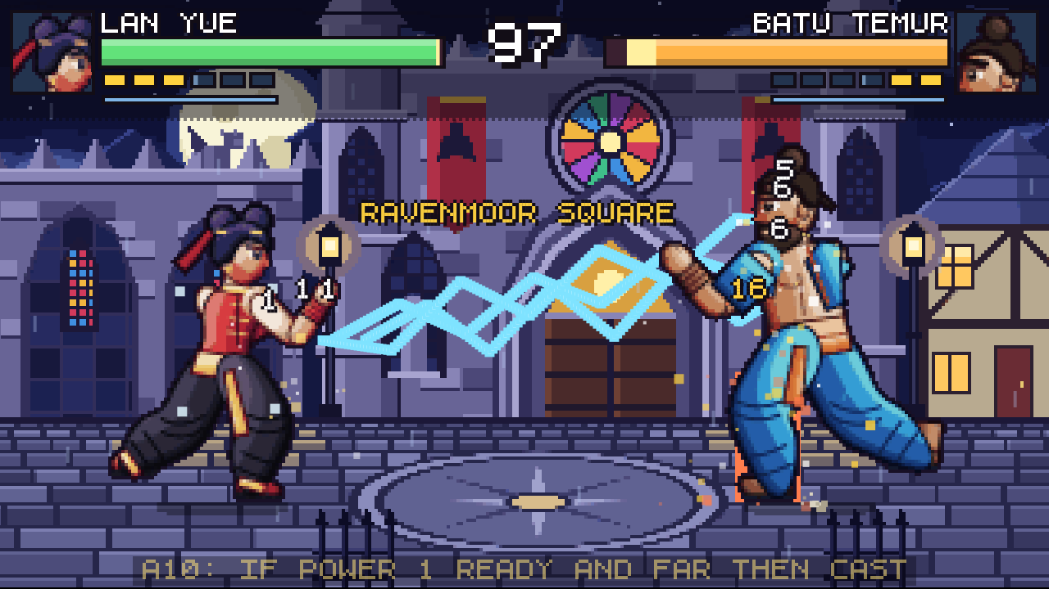
The final trial: can Pip be trusted with the loan desk?
NEXT
Test Bank: Pip’s Library Trials
Take it as one sitting
Study Guide
Start with your hardest activity
Optional: Rulebound. The ringed line is the rival’s rule:
Video Tutorials 01–07
Pause before each trace, and predict
IF POWER 1 READY AND FAR THEN CAST
风味小吃 · Software and Symbolic AI · Slides V1
Notes:
TIME: about 1 min 15 s (running total about 31 min)
BEFORE THIS SLIDE:
• If anyone asks for the seven videos: 01 From Everyday Decisions to Software. 02 Algorithms and Data Structures: Steps and Storage. 03 From a Library Problem to Tested Software. 04 Facts, Logic, and Symbolic AI. 05 Knowledge Representation and Rule-Based Systems. 06 Planning and Problem Solving: Search for a Goal. 07 Language, Rules, and Two Assistants.
READ ALOUD:
The Head Librarian has one more question: can Pip be trusted with the loan desk? That is the final trial, and it is in the Test Bank.
It has 24 true-or-false statements, 38 multiple-choice questions and 6 case files. Take it as one sitting. Its Score Sheet sends you back to any chapter you need.
The Study Guide has twelve missions, 16 activities and 25 quick challenges. Start with the activity you found hardest today.
The seven videos can be paused and replayed, so pause before each trace and predict.
Rulebound is the team’s own pixel fighting game, with one stage per chapter. It is optional, and nothing else depends on it.
The rival’s IF-THEN rules appear on screen as it fights, like the ringed one here. It uses forward chaining and priorities. It does not search or learn.
Now let’s close with thanks and credits.
SEE ALSO: Test Bank: Pip’s Library Trials. Study Guide route table. Game: Supporting_Files/Game_Rulebound/rulebound.html in the Study Guide and Test Bank ZIP.

Slide 26

Team, sources and credits
END
Team 风味小吃 (Fengwei Xiaochi)
Gunawan Nicolas Benedictus
Ritchard Alexander
Eizel Mthana Conqueror
Frederic Chandra
Louis Alexander Dalim
Frederick Bryan The
Sources
The professor’s PPT 2024, chap3 and chap4
Forouzan (2018); Brookshear and Brylow (2019)
Russell and Norvig (2021); Sommerville (2016)
Davis et al. (1977); Weizenbaum (1966)
Scratch; Machine Learning for Kids (D. Lane)
Full list: Study Guide, “Resources, references and credits”
Module: Software and Symbolic AI · Team 风味小吃 · PPT Slides V1
Built from Module Contents V3 and Study Guide V1.4. Thank you, from Pip.
风味小吃 · Software and Symbolic AI · Slides V1
Notes:
TIME: about 20 s (running total about 32 min)
BEFORE THIS SLIDE:
• Credit details (not read aloud):
• Module: Software and Symbolic AI. Team 风味小吃 (Fengwei Xiaochi). PPT Slides V1, built from Module Contents V3 and Study Guide V1.4.
• Team roles, as listed in the Study Guide: Gunawan Nicolas Benedictus, Coordinator. Ritchard Alexander, Content Lead. Eizel Mthana Conqueror, Visual Design Lead. Frederic Chandra, Quality Lead. Louis Alexander Dalim, Repository and Submission Lead. Frederick Bryan The, Video Lead.
• Full references with page numbers: Study Guide, “Resources, references and credits”, and Module Contents V3.
• Art: the restaurant pictures and Pip are original to this project, drawn with AI assistance, with Adobe lens blur, halftone and film grain on the backgrounds. Slide transitions are PowerPoint’s own Morph. Significant AI assistance is recorded in the team’s logs.
READ ALOUD:
That is the end of the module: Software and Symbolic AI, from Team Fengwei Xiaochi. Our full references, with page numbers, are in the Study Guide. Thank you, from all of us, and from Pip.
SOURCE: Study Guide, “Resources, references and credits”.

